Slide 1



Fighting Robot Event Scheduling
With Firebase, Angular, and Netlify

Slide 2


About Me
Father of two, fighting robot builder, and director of the Technology Enablement Team at EnergyCAP. I enjoy all things engineering, especially inspiring young people to pursue it.
https://www.energycap.com/careers
Zac ODonnell
Director of Technology Enablement
EnergyCAP LLC
zac.odonnell@energycap.com
Let’s Connect!

Slide 3
Goals of the Talk
This talk WILL…
Introduce Concepts
Show real examples in action
Show a simple hosting solution
Include extra detail slides for later
This talk WILL NOT…
Cover everything from scratch
Dig into all the details
Be perfect. We’re all learning here.

Slide 4
What Even is Firebase?
Google’s platform for scalable, cross-platform applications.
Composed of several integrated parts:
Firestore DB - Centralized Document-based data storage with real-time updates
Firestore Functions – Serverless JS functions like Azure Functions or AWS Lambda
Firebase Storage – Similar to azure Blob or AWS S3
Authentication, Security, and Hosting – all included

Slide 5
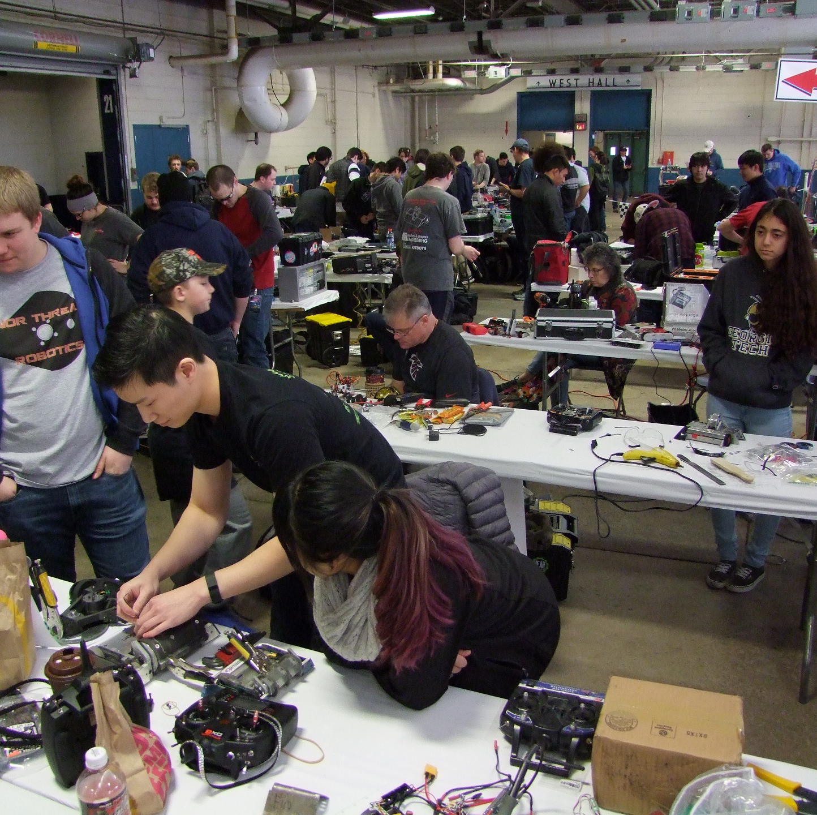
Ever wanted to be a fighting robot builder?
Today you can! We will take a technical look at what is involved in coming to an event, going through safety inspection, getting on the fight list… and the software that tries to tame the chaos

Slide 6
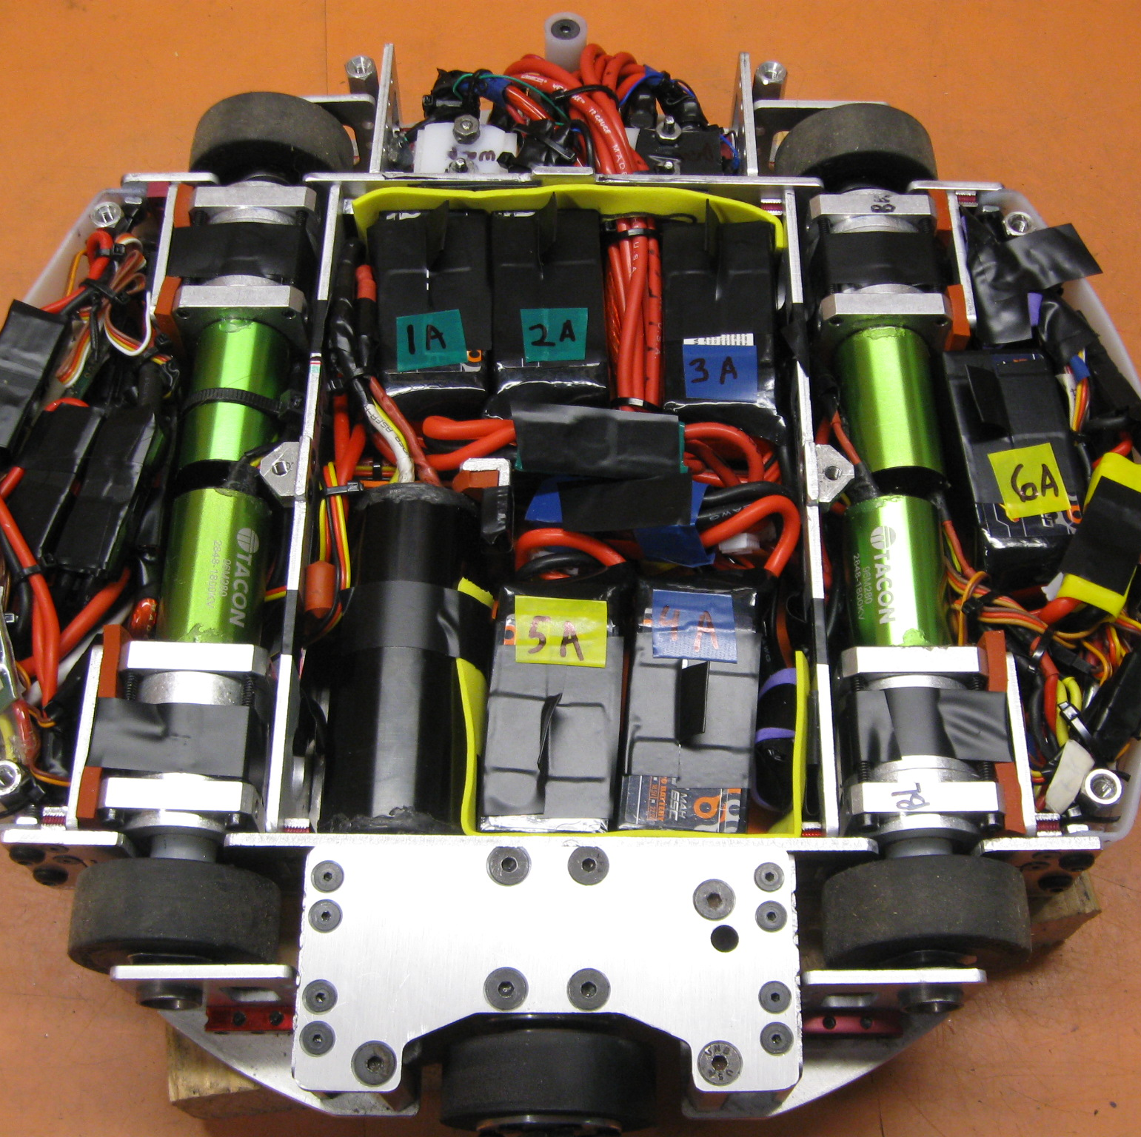
Entering the Tournament
Pre-event registration
Safety inspections

Slide 7
Entering the Tournament
Pre-event registration
BotEvent data model FireStore DB
Safety inspections HTTP api firebase function Mark bot as Inspected
Image upload and resize
Firebase file storage

Slide 8
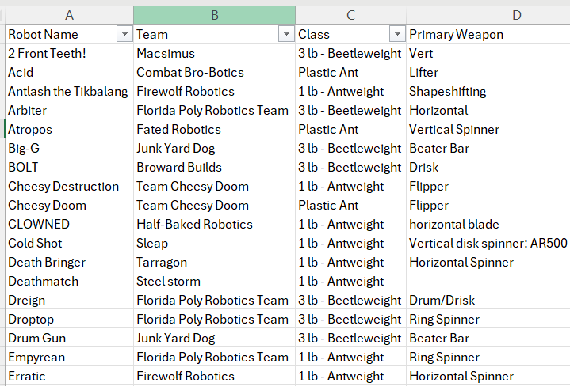
Pre-Event Registration
Separate system handles registration
Exports a spreadsheet like this
Reformatted into bots in an event in Firebase DB ahead of time

Slide 9
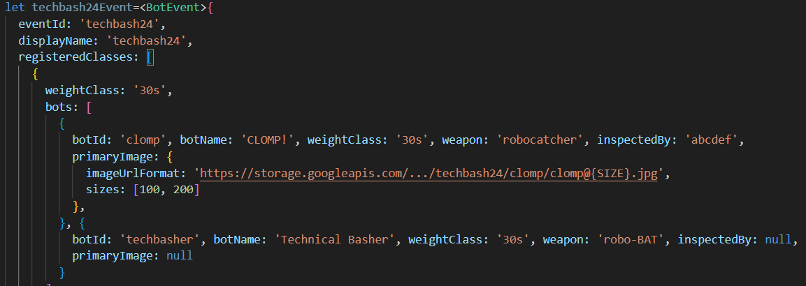
Pre-event Registration: BotEvent model

Slide 10
Pre-event Registration: BotEvent model

Slide 11
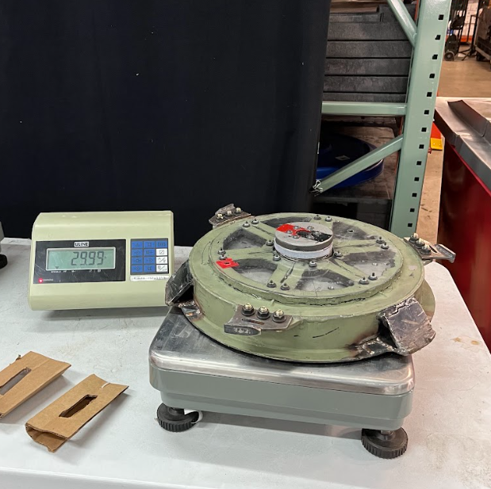
Demo: Safety Inspection
Weapon type compliance
Weapon lock
Power switch access
Weight check
Functional test and Failsafe
Mark as inspected
Snap a picture
Notes:
Brief ‘fake’ inspection. Show step 6 and 7 as separate actions on the laptop. Dig into each coming up. We’re inspecting “Hyperpolarized.”. Redo

Slide 12
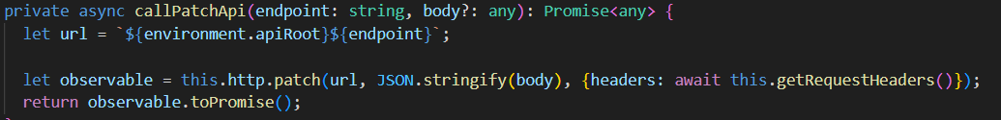
Digging In: UpdateBot HTTP (Client)
using Angular HTTP like you would for calling any HTTP API.
Feedback to user done with simple “toast” message

Slide 13
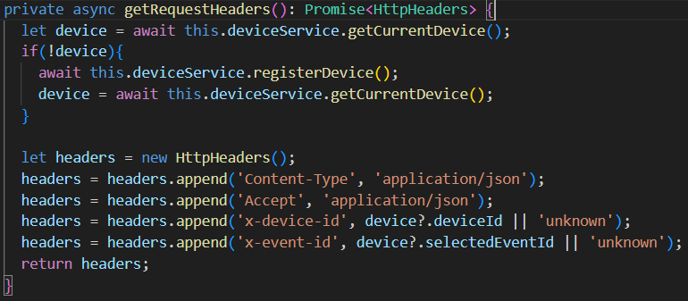
UpdateBot HTTP (Client)
Genericized HTTP calls (all HTTP Methods) to include default headers used by API to understand and authorize request.
Not using Firebase Auth for this application, but you may want to
Application-specific

Slide 14
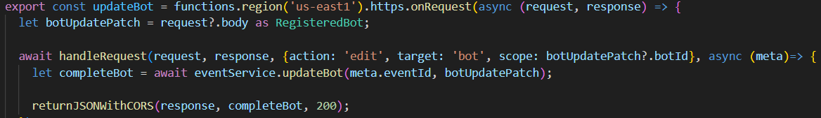
UpdateBot HTTP Function (Server) Firebase HTTP Function
An entrypoint is just an exported function from index.ts. Region is only firebase-specific code here
handleRequest and returnJSONWithCORS are custom functions to handle CORS, look for the two required custom headers, and provide exception handling. This has become much easier and more integrated in more recent versions of firebase functions.

Slide 15
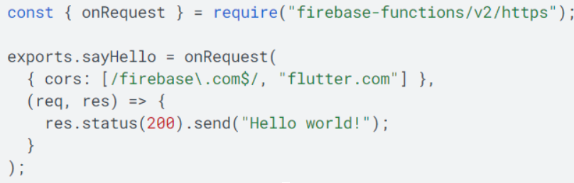
HTTP Function Syntax Improvements
Firebase v2 functions have a much-simplified syntax for that same wrapper logic

Slide 16
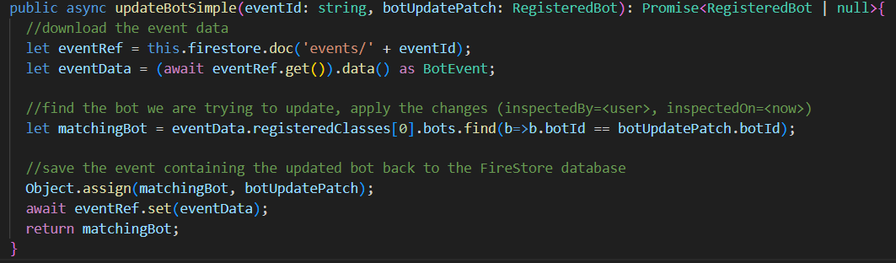
UpdateBot – Firestore Data Access
Updating a document in storage can be very simple
… But we know life is not actually this simple. What is wrong with this approach to data access?

Slide 17

Update Bot: Concurrent Writes
A little too deep for this talk
Supported by Transactions
Most operations assumed to be concurrent in applications like this
Examples included after slide deck as an appendix

Slide 18
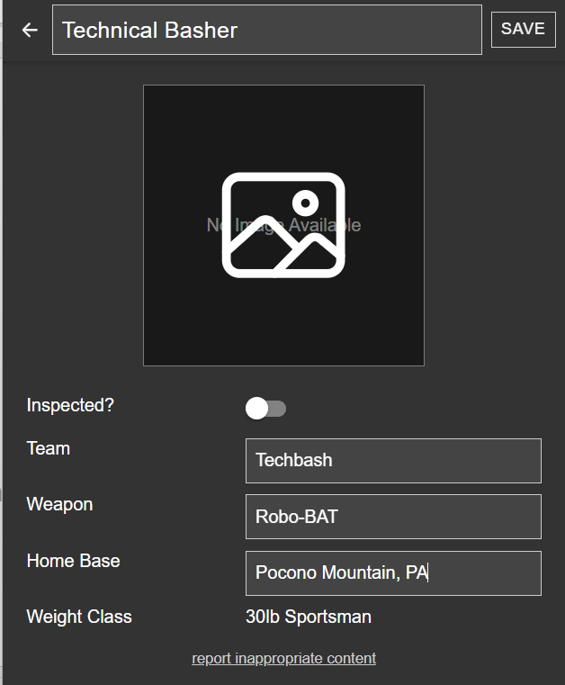
Demo: Safety Inspection - Image Upload
Weapon type compliance
Weapon lock
Power switch access
Weight check
Functional test and Failsafe
Mark as inspected
Snap a picture

Slide 19
Demo: Safety Inspection - Image Upload
Snap a picture
Upload it to Firebase File Storage
Capture the URL
Call an API to ‘publish’ it
Authorize access
Resize to thumbnails
Attach to correct robot

Slide 20
Image Upload (Client)
The Bot Inspector needs to choose an image (or take a picture with their phone), make sure it looks ok, then upload it to be resized and attached to the correct bot.
This helps other builders know what they are up against, and audience members find the coolest looking bots to subscribe to.

Slide 21
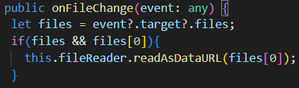
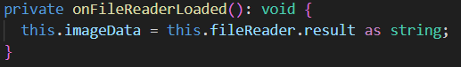
Image Upload (Client)
A simple input type=“file” automatically prompts for camera or upload on a phone, and allows uploading a picture you already took on a laptop
FileReader (default Javascript API) has an event for when data changes that captures the image data. This is shown to the user as a preview and they can choose to rotate it if the EXIF data made it look wrong

Slide 22
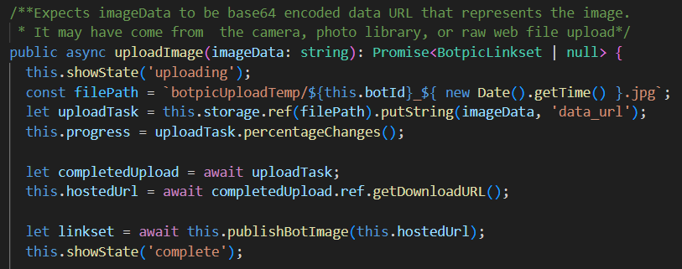
Image Upload (Client) Firebase Storage
When user likes the preview (or finishes rotating) they can choose to publish. That uploads the file, reports progress, and then calls the custom publishBotImage http endpoint to kick off resize and connect everything

Slide 23
Handling the Image (Server) Firebase HTTP Function
Ok, the Upload happens, and we told the API to resize the image and attach it to the bot. How does that fancy stuff actually happen?

Slide 24
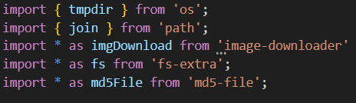
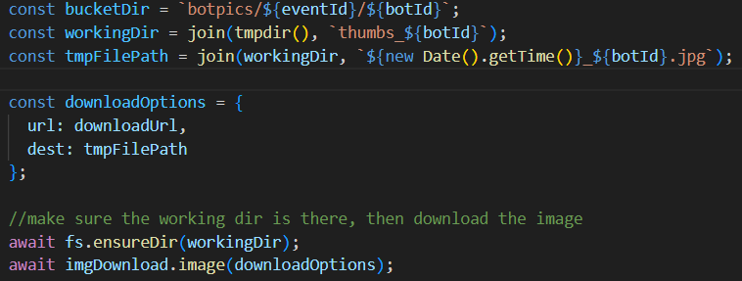
Download from Storage (Server) Firebase Storage
Before publishing, we uploaded the image to a public drop location to be able to use the native file upload and progress handling. Now when publishing we need to download the file to local disk to do resize and re-upload of thumbnails.
… we get by with a little help from our friends

Slide 25
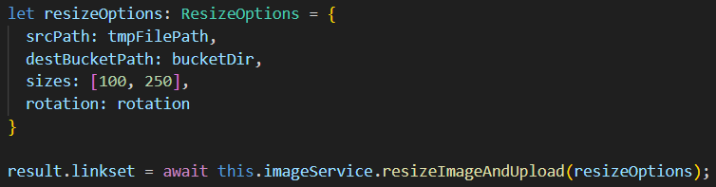
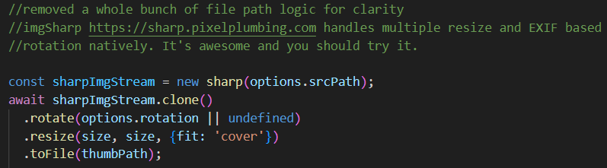
Actually do the Resize (Server) ImageSharp library
Define the resize settings, and actually do the resize on disk
… we get by with a little help from our friends

Slide 26
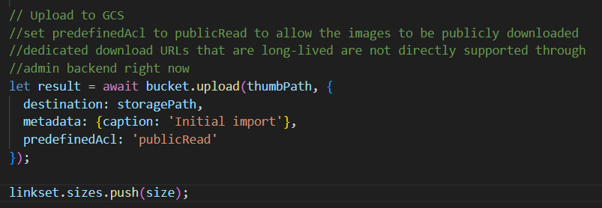
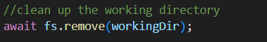
Upload the Thumbnails (Server) Firebase Storage
Upload the generated thumbnails back to storage in a way un-authenticated users can see them. Almost there!
Then once all uploads are done we can clean up the local working directory

Slide 27

Additional Triggers Firebase Functions
Http Triggers (shown today)
Document or collection changes
Schedule triggers
Details available in appendix after the slides

Slide 28
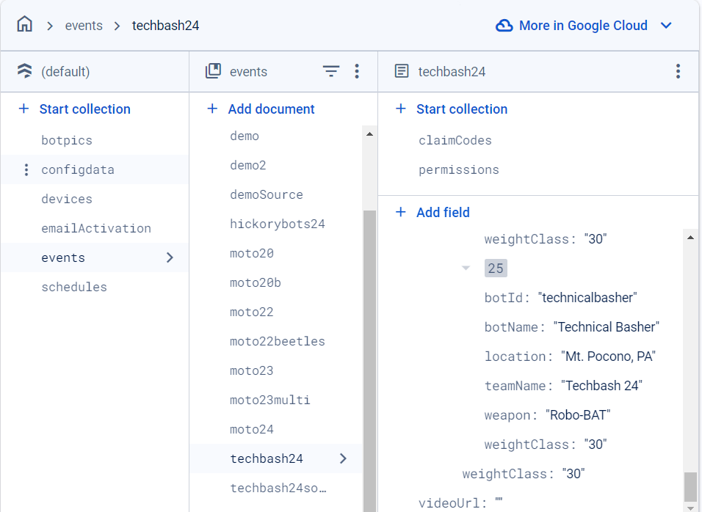
Demo Behind the Scenes: Safety Inspection
Inspection of Technical Basher on the phone
This time watch from the Firebase Console
Notes:
Repeat inspection on the phone, take pic of the room as segway into ‘readonly’ flavor

Slide 29
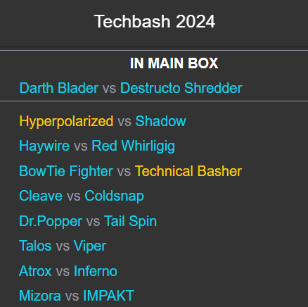
Fight Robots, Fight!
Watching the fight list on the client
Chaining multiple subscriptions for device, event, and fight list updates so no matter what changes, the app reacts

Slide 30
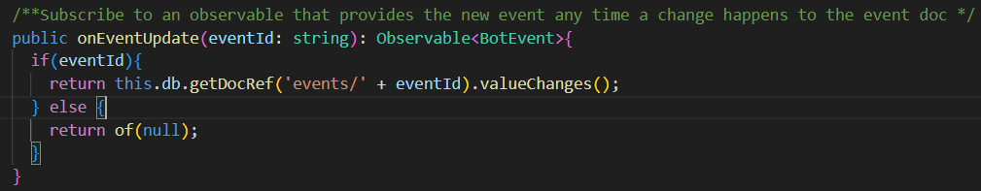
Watching a Document for updates AngularFire client library
AngularFire makes observables that fire on any doc update a one-liner.
Using it to trigger code that reacts is trivial too

Slide 31
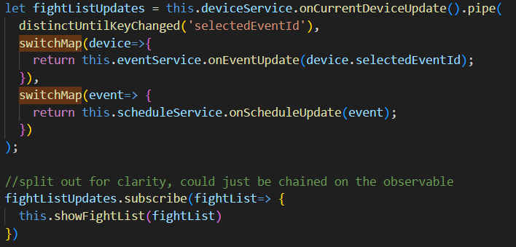
Chaining Subscriptoins AngularFire client library + RXJS
If the user changes what event they are viewing, or the event has a new robot added, or the fight list updates with new fights on the list… we need to react and update the fight list itself to have the right names listed, with the right links. RXJS and AngularFire2 make this super easy.
Using it to trigger code that reacts is trivial too

Slide 32
Benefits
Updates to the list are in near-real-time
Synchronization behavior is built into the framework – focus on your logic, not getting data
Includes support for intermittent connectivity, offline status, wake-from-sleep etc.

Slide 33

Additional Query Options
Firebase supports querying and watching individual documents or whole collections
Queries can target specific document properties and use several comparison operators
Ordering requires indexes to be defined to ensure scalability
Examples included after slide deck as an appendix

Slide 34
Continuing the Fight
Topics beyond the scope of this talk that are worth digging into
Firebase Authentication – integrate with OpenID Connect, Federated Identity, etc
Rule-based security
Firebase Cloud Messaging for Push Notifications
Performance tuning
Detailed Pricing – this app costs less than $1 a month in Firebase costs to run.
See additional appendices at the end of this presentation for extra detail on several items

Slide 35

Hosting, Deployment, and Environments
Goals
Low budget
Publicly accessible hosting
Separate dev and production environments
Simple deployments
Low maintenance

Slide 36
Netlify’s Solution
Goals
Low budget
Publicly accessible hosting
Simple deployments
Separate dev and production environments
Low maintenance
Features
Free tier for static file apps (f’real!)
Includes SSL, Subdomains, DNS
Auto deploy from changes to any branch
Build scripts and variables per environment
Once set up, it ‘just works’ any time you push code. No SSL renewals, restrictive activity limits, etc.

Slide 37
Demo: Netlify Configuration

Slide 38
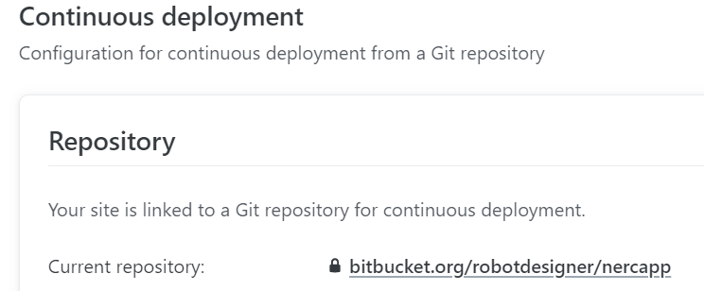
Netlify: Simple Deployments
Git Integration
Attach to git repo
Defaults to treating master as production
Authorized via OAUTH
Setup takes about 3 minutes from creating your account to first deployment

Slide 39
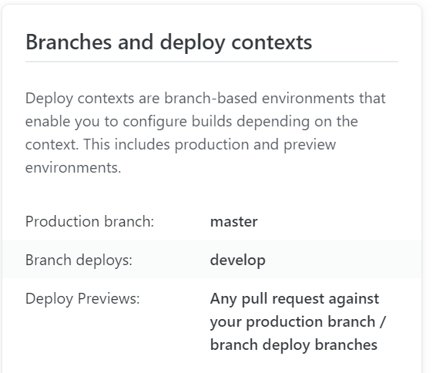
Netlify: Simple Deployments
Branch Deployments
Branch deploys for “develop” branch means they have a dedicated URL that they auto-deploy to on push
Can configure previews on feature branches with automatic names if preferred.
Offers built-in split testing with configurable mix, if you want that

Slide 40
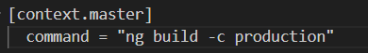
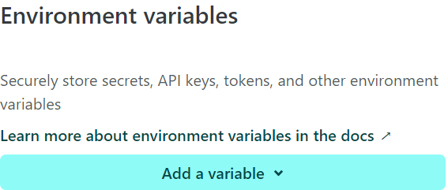
Netlify: Separate dev/production
Netlify.toml file at the root of the project for branch specific rules managed in code
Highly Configurable
Angular configurations used for development vs production settings
Default build script is “ng build –c development”
Netlify.toml file overrides build script to ng build –c production on master branch

Slide 41
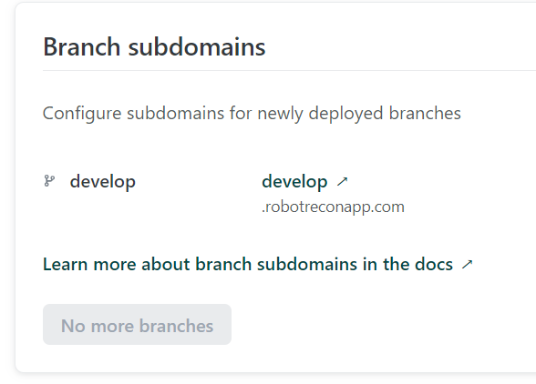
Netlify: Simple DNS
Setup
If using Netlify DNS (also free) you can define branch subdomains for all configured deploy branches
Can also add CNAME, TXT, SPF etc records

Slide 42
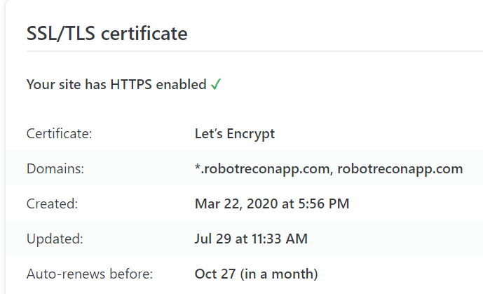
Netlify: Simple SSL
Defaults are great
Free SSL certificate, including subdomains, through LetsEncrypt
Automatic renewal built-in and on by default
Supports custom cert if you need a different authority

Slide 43
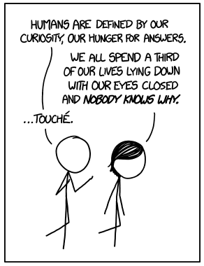
Questions?
Zac ODonnell
Director of Technology Enablement
zac.odonnell@energycap.com
Credit: XKCD - https://xkcd.com/1345

Slide 44
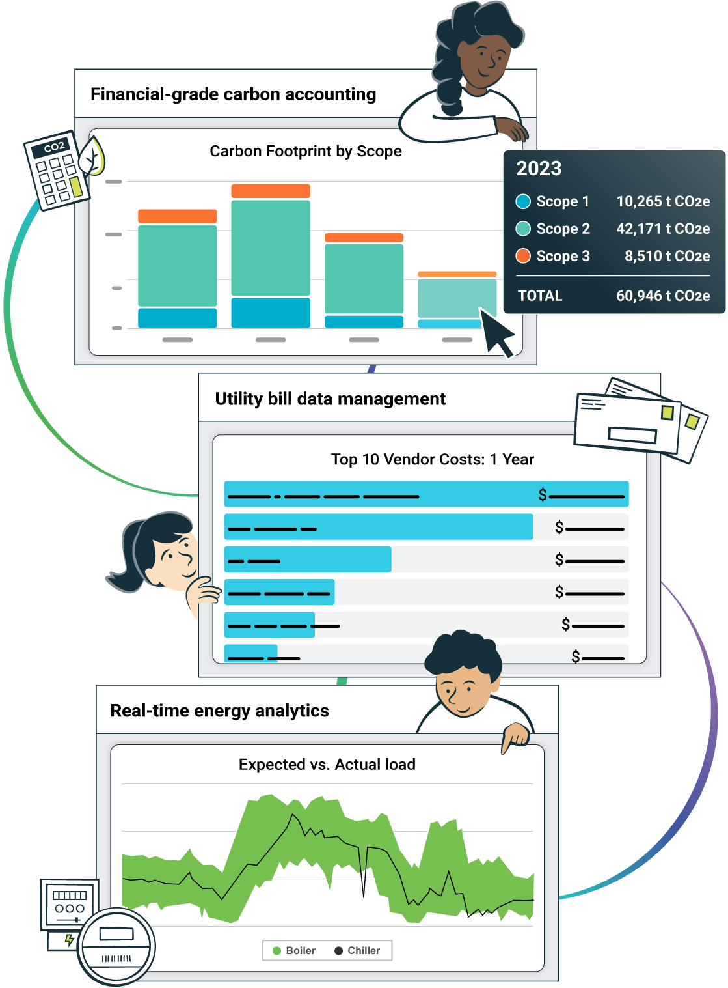
The single source of truth for energy and sustainability teams
Our energy and sustainability software gives you instant access to actionable data you can trust to better manage resource consumption, reduce your carbon footprint, and drive massive savings.

Slide 45
Appendices: Extra details that didn’t fit
An hour talk just isn’t enough to include all the cool things around Firebase that help to connect the dots with an application like this. I’ve included additional slides below as additional details from matching summary slides in the presentation

Slide 46

Appendix: Concurrent Writes in Firebase

Slide 47
Appendix: Concurrent Writes in Firebase
Sharing the “BotEvent”
Every time a bot is marked as inspected, the name is changed, or the picture is updated it is a read-write pair of the event object
All inspectors, the scheduler, and all viewers share that event object
Firebase uses Transactions to allow these write operations to follow one after each other to prevent dataloss
Firebase Docs: Multi-document writes in transactions and denormalization

Slide 48
UpdateBot – Concurrent Data Access
What if two different bots get inspected at the same time? Both updates could read the event details, make an update to one bot, then write all the event details back – wiping out the first change.
Last one wins = nobody wins.

Slide 49
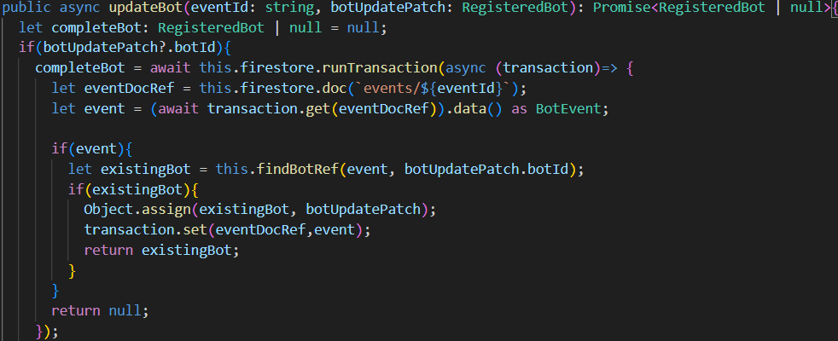
UpdateBot – Concurrent Data Access
Updating a single registered bot as part of an event requires a transaction for concurrent access protection

Slide 50
UpdateBot – Concurrent Data Access
Updating a single registered bot as part of an event requires a transaction for concurrent access protection

Slide 51
Appendix: Additional Triggers in Firebase Functions

Slide 52
Appendix: Additional Triggers Firebase Functions
Types of triggers for several different use cases
Http Triggers are used extensively in the app when triggered by a user action
Document or Collection Write, Create, or Update can be used for simple react-and-transform, capturing audit trail, or even complex scalable job queueing scenarios
Scheduled Jobs allow cleanup and polling-style tasks, using cron syntax

Slide 53
Cleanup after the Party (Server)
Image Upload starts with the full-size image uploaded directly from the client. The publish call may never come. Who cleans up?

Slide 54
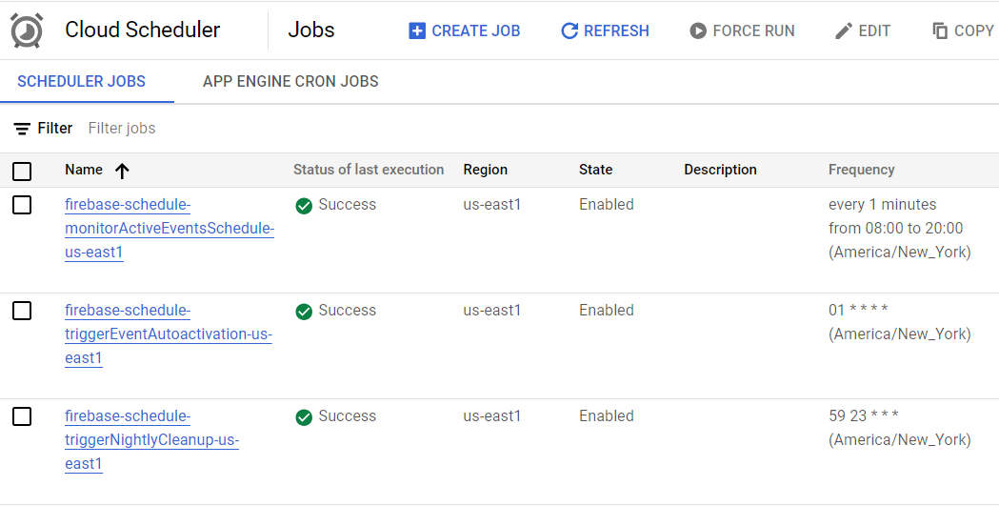
Cleanup after the Party (Server) Firebase Functions (pub/sub and Scheduler)
The Firebase Schedule Trigger

Slide 55
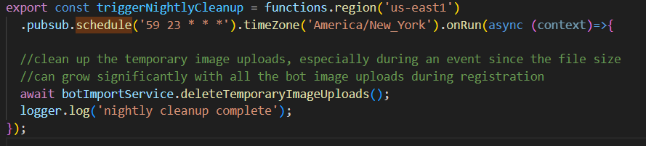
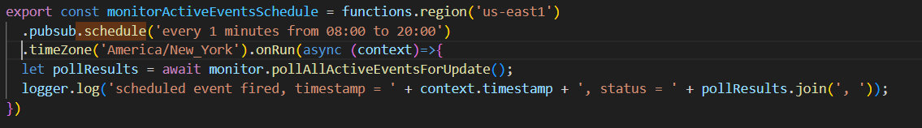
Cleanup after the Party (Server)
Firebase includes built-in access to the google cloud scheduler with cron-style syntax. Here it runs at 11:59 every day in the US Eastern Time Zone
There is an alternative, more human-readable syntax too. Here I’m using it for polling a webpage for schedule updates every minute but only “during the day” to avoid spamming notifications for an event on the east coast.

Slide 56
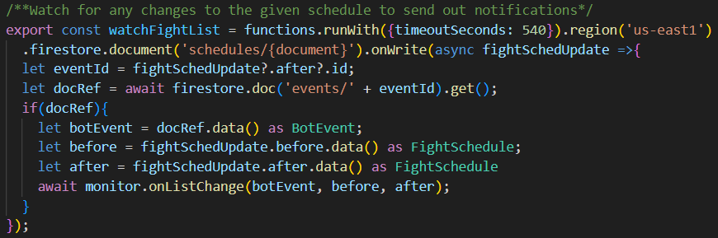
Document Triggers Firebase Functions
You can also trigger functions on document creation and updates. This can be used for lots of things from simple post-processing steps to complex job-queueing-and-scaleout situations.
Can use .onWrite, .onCreate, .onUpdate depending on your needs

Slide 57

Appendix: Querying Details

Slide 58
Appendix: Querying Details
Queries are designed for scalability
The query options are simpler than using SQL on relational tables because it is a document storage system, and it is designed for maximum scalability
You can’t say “where name like ‘%smith%’” for example
Ordering results requires indexes to be defined
Firebase error messages if you are missing an index help you create them
The sequence you apply filters in can dramatically affect cost and performance of your queries
Additional Firebase docs on querying

Slide 59
Additional Query Options
Firebase has a suite of query options. This app has limited needs for querying – the most complicated is finding all devices subscribed to one of the bots that just changed position on the list:
The size of the “any” list is limited to 10 options, and multiple queries are used to cover the 18 available slots on the fight list.

Slide 60
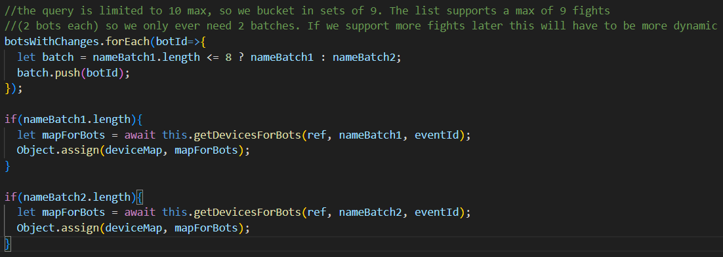
Array-contains-any Limitations
The size of the “any” list is limited to 10 options, and multiple queries are used to cover the 18 available slots on the fight list.

Slide 61
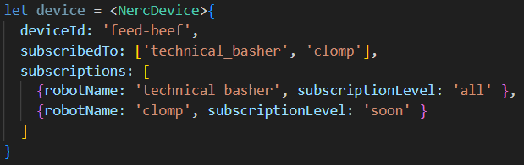
Additional Query Options: Denormalization
The Device model uses data duplication to enhance query performance and support.
This is fairly common in document databases, even across documents.
Multi-document writes in a transaction are required to maintain consistency
Firebase docs on data structuring

